Slide 1
Consumer Trends in a Post Pandemic Society
A study on health and hygiene trend in a post-pandemic market, with focus on PPE, its use, and its sentiments within Canada
Team Members:
Geng, John
Ijaz, Arsam
Teh, Marco
Project 1
Data Analytics Bootcamp
University of Toronto
2023 / 02 / 14

Slide 2
Introduction
Consumer Sentiment on PPE and Personal Hygiene based on online search trends
Business Reactions to Adopting PPE as Part of the Mandatory Health Protocol
Price Trends in online markets for specific PPE - Masks
Study is based on canadian datasets recorded at multiple points over 2018 - 2023

Slide 3






Data Sources
Apify - Google Trend Scraper
Canadian Government Open Statistics Database

Slide 4
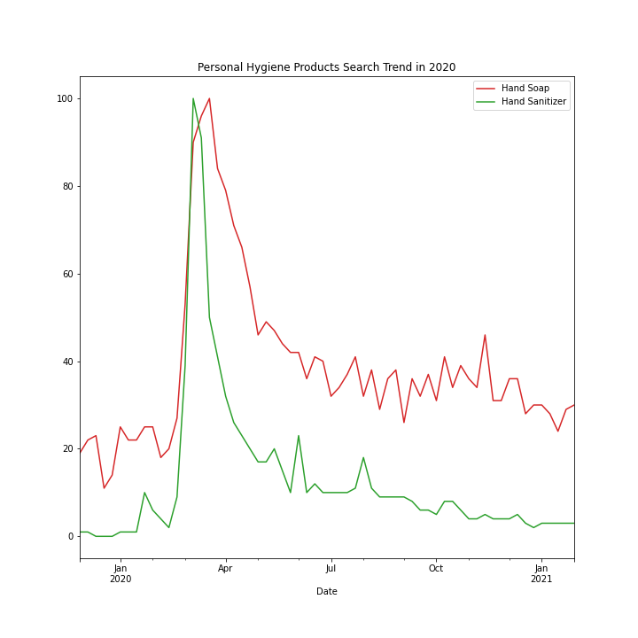
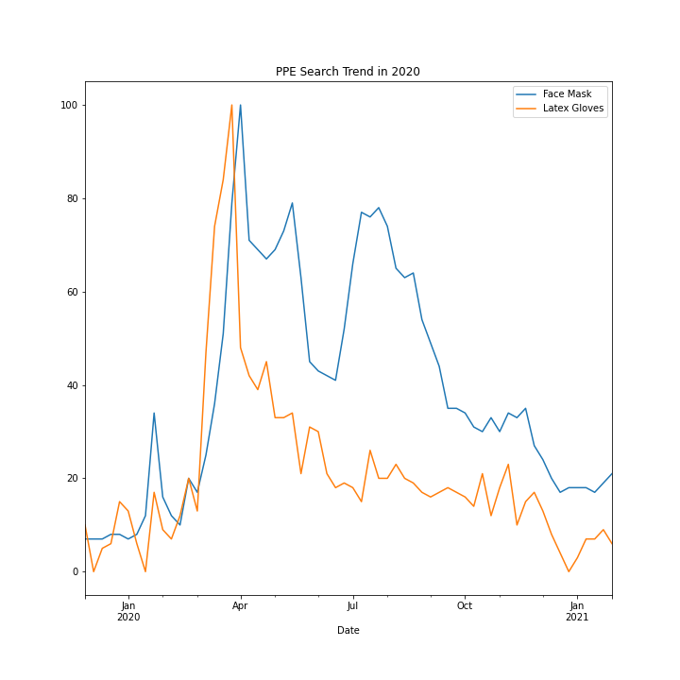
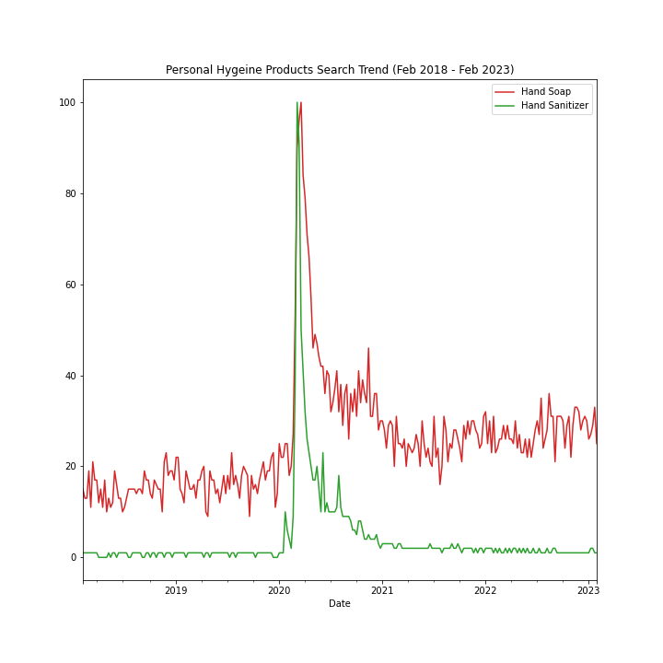
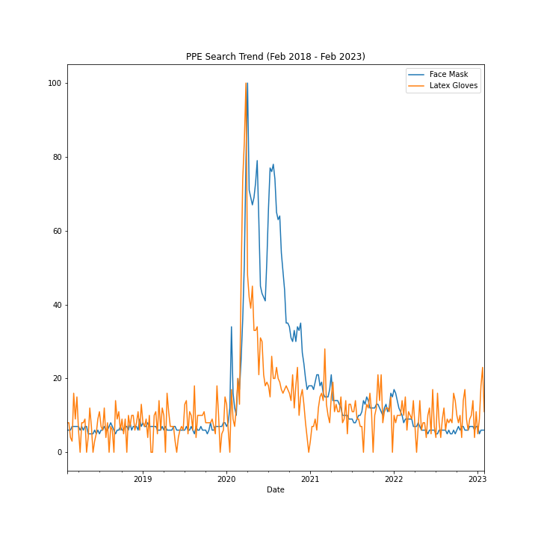
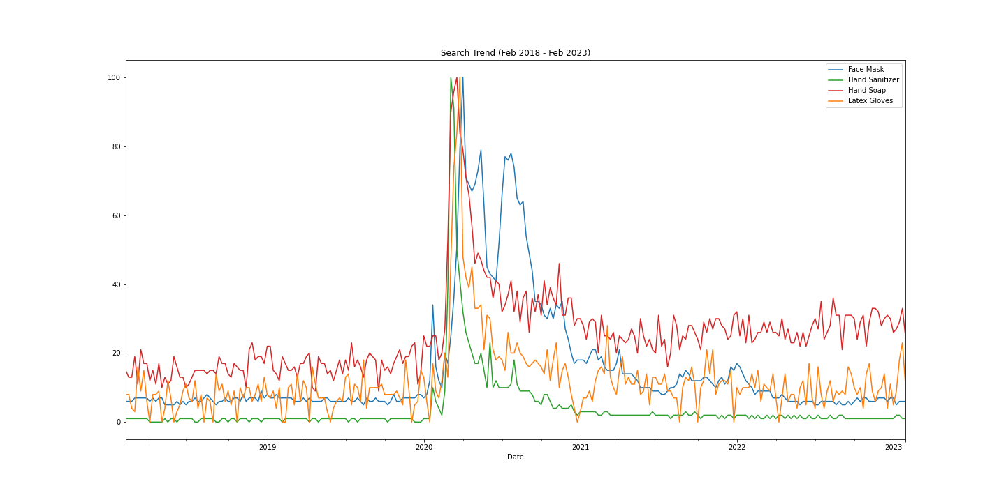
Google Search Trends in Canada

Slide 5
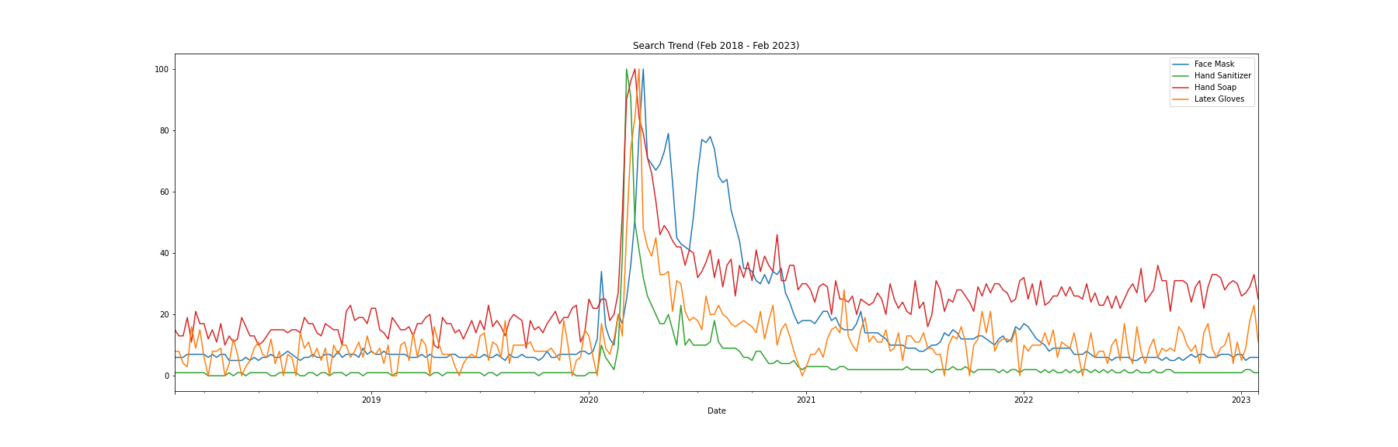
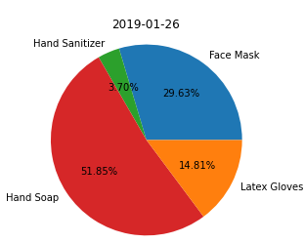
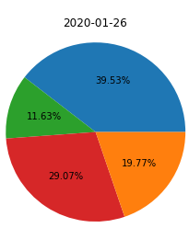
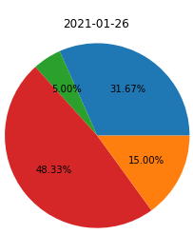
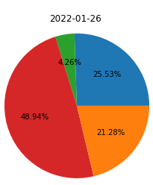
WHO declares Covid Pandemic
Mar 11, 2020
First Case in Canada
Jan 25, 2020
Face Mask: 7.15
Latex Gloves: 8.13
Hand Sanitizer: 1.00
Hand Soap: 16.91
44.69
23.80
15.18
42.27
13.25
11.38
2.17
25.49

Slide 6
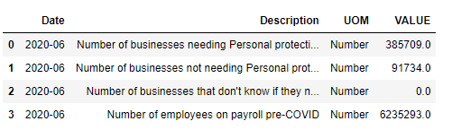
PPE Demand at onset of Pandemic
Notes:
As we may already know, apart from industry-specific PPE needs such as in pharma and etc. demand for PPE is in the business sector is almost non-existent. However, due to government restrictions, a sudden spike in demand has been created because they were needed for businesses considered to be essential to operate during the pandemic. This paints a picture of a previously non-existent trend emerging from a sudden cause.
This data is a screenshot during the first reopening during the peak of the 1st wave of covid. During this time, essential services and regulations were established.

Slide 7
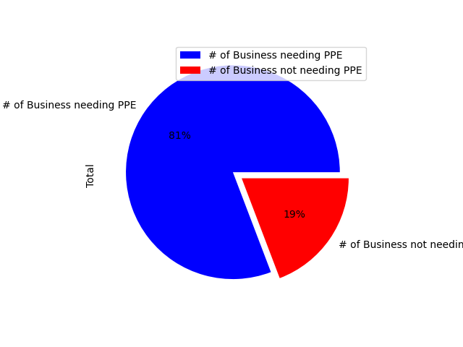

Breakdown of Demand
Notes:
Out of the 6.2m essential personnel at the beginning of the pandemic, 5m are on-site employees and need PPE; 1.2m are off-site or remote employees and do not need PPE. The exact breakdown of specific PPE demands and units per person is unknown and/or data is too unreliable to show, we can surmise that an automatic demand has been created from seemingly nowhere or easily created from government regulation.

Slide 8
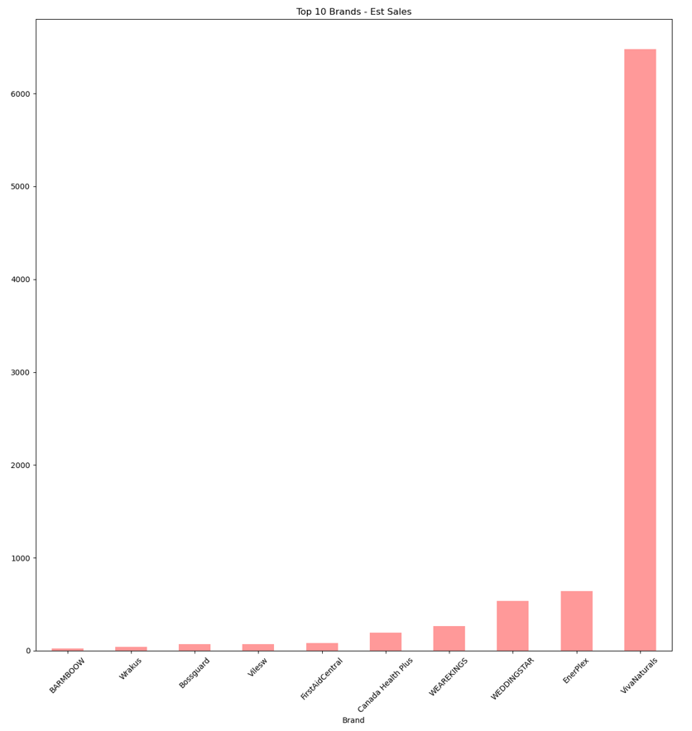
AMAZON BESTSELLERS - TOP 10 FACE MASK BRANDS
Top 10 - Ranks
Viva Natural
EnerPlex
Weddingstar
Wearekings
Canada Health Plus
First Aid Central
Vilesw
Boss Guard
Wrakus
Barmbow

Slide 9
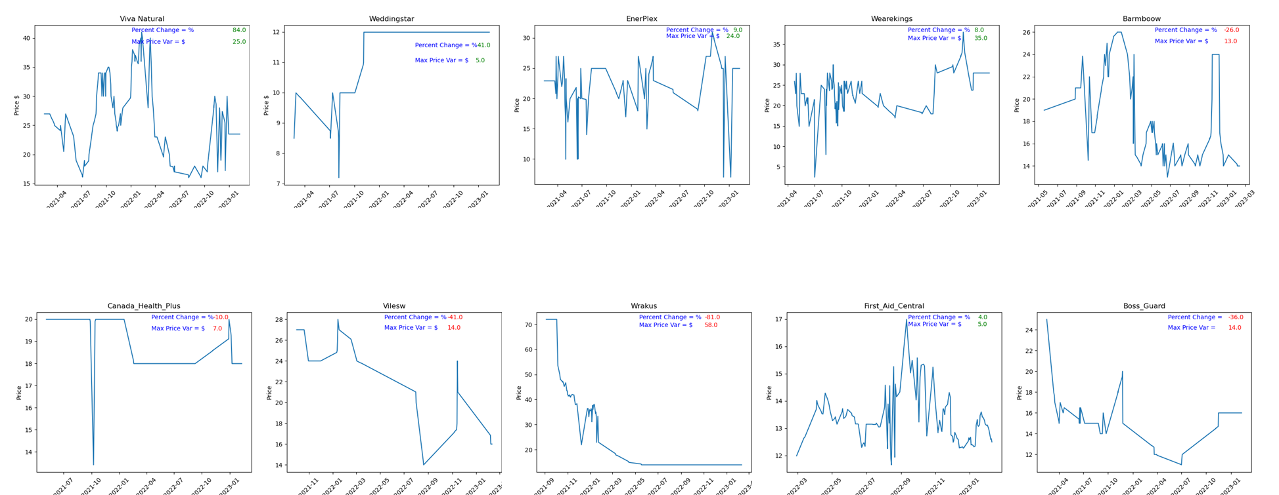
Price Point Changes Over Covid - Face Masks
Visual of price point changes of top 10 bestseller face mask brands on Amazon, with a focus on a) points of fluctuation, and b) stability

Slide 10
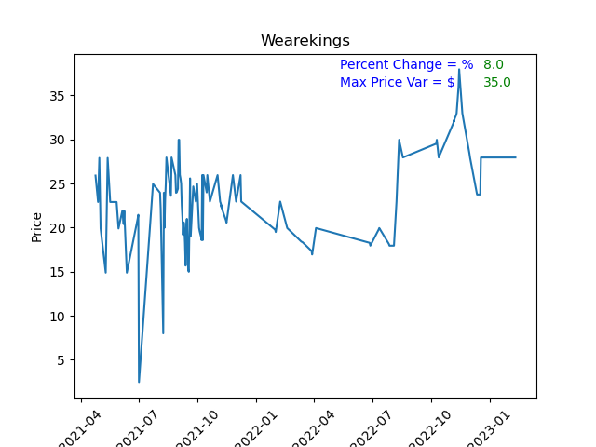
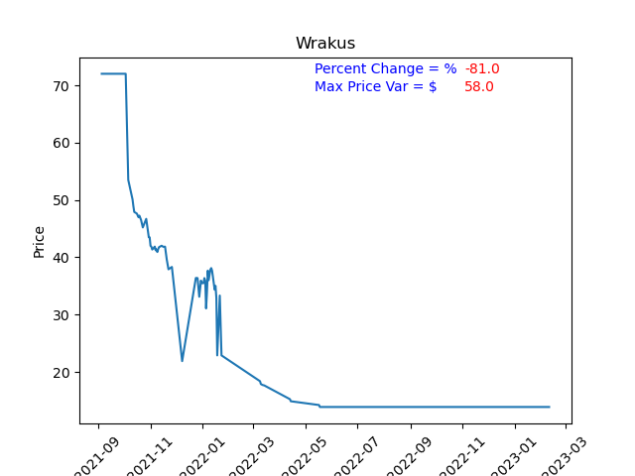
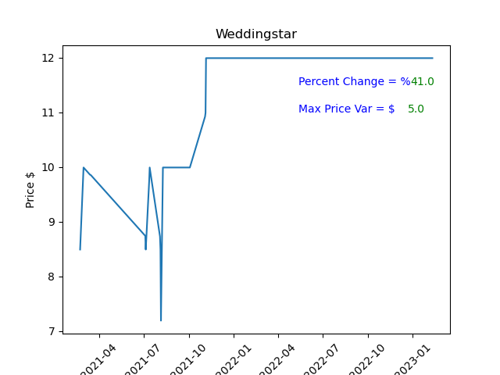
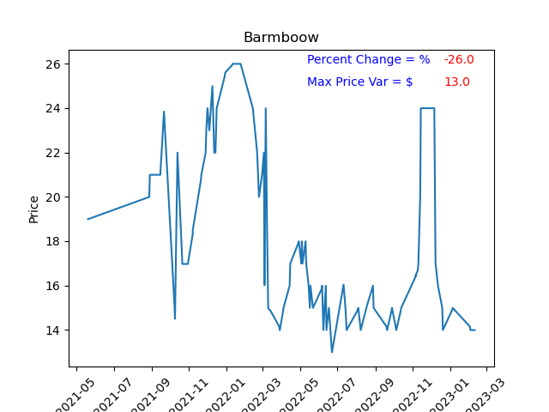
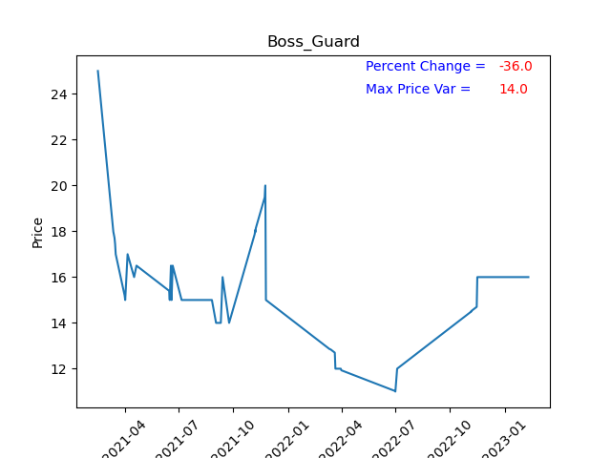
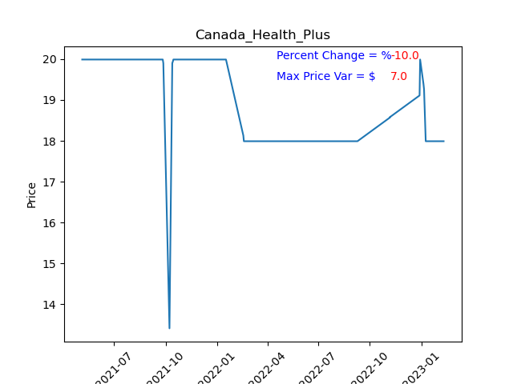

Slide 11
Conclusions
The general public is still very reactive to PPE protocols whether its to show compliance or defiance, and we will continue to see this as the world face changes
Although demand has tapered off for the business sector significantly, the pandemic may have created a new trend as businesses are now opting to promote a voluntary PPE policy in the workplace. Whether this becomes a permanent practice is yet to be determined
PPE price fluctuation has decreased within the top brands, however current price points for PPE brands that emerged over COVID have changed drastically, and we can see that from the percent change shown

Slide 12

Thank You! And Stay Safe.

